Slide 1
Peace Psychology Considers Abortion

Slide 2
Continuum of Positions
Option Violence
Tragic Necessity

Slide 3
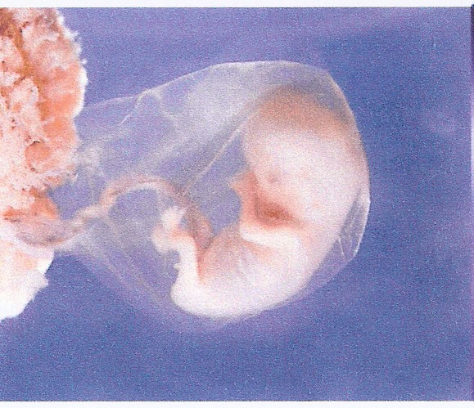
Status of Fetus
OPTION: Non-person / Tissue
VIOLENCE: Human Being / Baby
TRAGIC NECESSITY: Like Animal

Slide 4
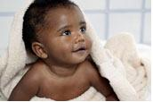
Child Abuse

Slide 5
Hypotheses: Child Abuse
Option: Because unwanted children are for the most part not born, child abuse and neglect (excluding sexual abuse) will be lower in those places and times in which abortion is legal or otherwise readily available.
Violence: Because abortion models violence as a way of solving problems, and diminishes the taboo against hurting children, child abuse will be higher in those places and times in which abortion is legal or otherwise readily available.

Slide 6
Child abuse rate per 1,000:
1973 – 2.16
1990 – 11.59
(Bureau of Census)
The child abuse rate and the abortion rate both fell steadily after this.

Slide 7
Coleman et al. (2005)
518 women identified by Baltimore Child Protective Services as having abused their children.
at least one induced abortion: 114% more likely to be identified as having abused their children, compared to women with no loss.
Involuntary loss (miscarriages) were no more likely to be identified as abusive than women with no pregnancy loss.

Slide 8
Problem of the Super-Wanted
Lenoski (1980), 674 emergency room visits due to abuse compared with 500 controls from the same emergency room
91% of the parents of abused children said they had wanted the pregnancy; 63% of the non-abused said so;
93% of the parents were married at the time of the birth of the abused child; 60% of the non-abused were;
the mother of the abused children began wearing maternity clothes at an average of 114 days into the pregnancy, as compared to an average of 171 days for the mothers of the non-abused children;
The child was named after a parent (usually, father’s name with “Jr.”) in 24% of the abused cases, but only 4% of the non-abused cases.

Slide 9
Intimate Partner Violence

Slide 10
Many, many studies
IPV is more likely to lead to a pregnancy occurring that wasn’t wished for.
IPV is more likely to lead to coerced abortions, as coercion is already inherent in the relationship.
The prevalence of IPV is about three times greater in those seeking abortion than in those continuing their pregnancies.
These points aren’t controversial, but as for conclusions:
Any program preventing IPV also prevents abortion
and
Screening for IPV at abortion facilities can help find where interventions might help.

Slide 11
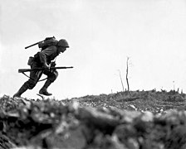
War

Slide 12
From the Washington Post
“[A] 33-year-old woman . . . said she struggled for weeks, trying to decide between her religion and her love for children on the one hand and her inability to support a newborn baby on the other. Finally she went ahead with the abortion.
The Catholic mother of two said she spent the night crying and praying . . . “I would never do this in peacetime and God knows I wanted that child, but there is no food for him in my house,” she said. “There is nothing. What could I do?”
Such stories are common and the dynamic is obvious – add this to the long list of reasons that war is intolerable.

Slide 13
Sex Trafficking

Slide 14
If someone is being trafficked — which is to say, under the domination of a pimp/trafficker — she is by definition unable to provide informed consent to an abortion . . . The victim has no voice in this decision. Indeed, providing such services to a victim of sexual trafficking benefits only the trafficker by getting the victim back out on the street and making money sooner.
The average age of entry into commercial sex exploitation is about 14. The average life expectancy of someone in commercial sexual exploitation is seven years. Start at 14, dead by 21. The mortality rate for someone in commercial sexual exploitation is 40 times higher than for a non-exploited person of the same age. Helping a victim return to exploitation more quickly by terminating a pregnancy increases the odds of death.”
-- Stephen Wagner, National Catholic Reporter, 11/29/2011

Slide 15
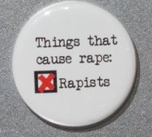
Sex Abuse and Rape

Slide 16
Impact of Abortion Availability on Sexual Abuse
We know of many cases where sexual abuse of minors continued because the perpetrator covered up the crime by taking her to an abortion clinic. Since efforts to conceal are mainly successful, there are undoubtedly many more.
Whenever abortion clinics don’t turn in the perpetrator, they facilitate him and therefore may sexual abuse more likely.

Slide 17
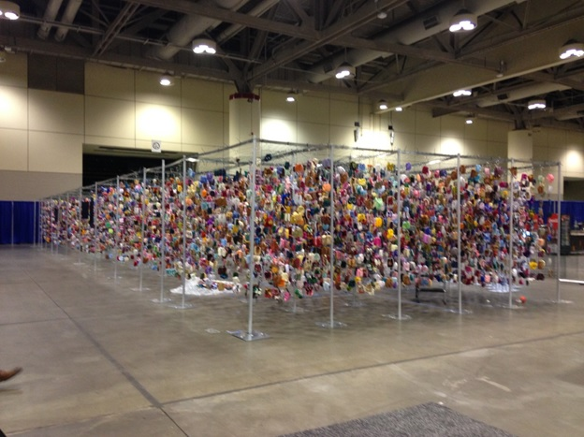
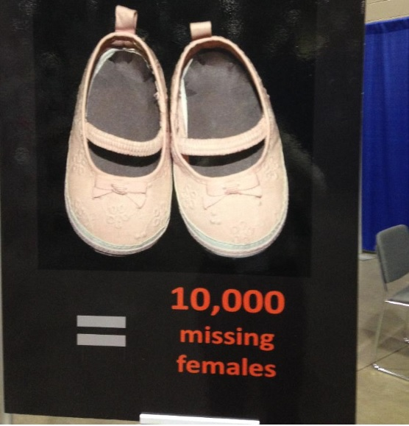
Gendercide

Slide 19
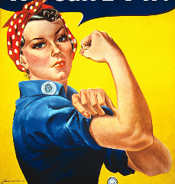
Impact on Women as Whole

Slide 20
Question: Equality
Option: Control of reproductive lives is necessary for women’s equality.
Violence: Telling women they must have surgery order to be treated equally is disparaging female biology and therefore a form of privileging male characteristics.

Slide 21
Question: Discrimination
Option: Forcing women to continue pregnancies is itself a form of gender discrimination.
Violence: When pregnancies are regarded as optional rather than a condition to be accommodated, then those employers and schools who understand themselves to be inconvenienced are more likely to discriminate against pregnant women.

Slide 22
Question: Pressure for Sex
Option: Women having control over their own bodies is all of a piece, including both sex and pregnancy. They are freer to have the sex they wish with abortion as an option.
Violence: We still live in a patriarchal culture in which men feel entitled to sex. The surgery of abortion is one that women undergo, but the man does not, so he’s not the one that takes the consequences.

Slide 23
Question: Pressure to Abort
Option: The option is for women; they make the decision.
Violence: Employers, men who want to avoid child support payments, parents who don’t want their teenager to embarrass them – the rhetoric of “choice” can mask the fact that it’s their choice, not hers.

Slide 24
Question: Feminization of Poverty
Option: Female poverty would go down as women aren’t straddled with children they can’t afford.
Violence: Female poverty would go up because men will feel justified in avoiding all paternal responsibility, including child support. The birth happened due to her choice, not his.
Epidemiological Result: After 1973, out-of-wedlock births and female poverty shot up.

